Slide 1

Air Quality Prediction
Presenter
Piyush Kumar Gupta
(e-ada-130)

Slide 2
Introduction
Air pollution, caused by human activities such as industrial emissions, vehicle exhaust, and burning of various substances, has significant consequences for the environment and human health. Pollutants like CO, CO₂, PM, NO₂, SO₂, O3, NH₃, Pb, etc., are continuously released into the air, posing risks to humans, animals and plants. The detrimental effects of air pollution include a wide range of diseases, from respiratory issues to cardiovascular problems and even lung cancer. Additionally, air pollution contributes to global warming, acid rain, reduced visibility, smog, aerosol formation, climate change and premature deaths. Greenhouse gas emissions from vehicles, power plants, factories and agricultural activities further worsen the impact on climate and hinder plant growth. The consequences of air pollution extend beyond human and animal health, significantly affecting agricultural productivity due to climate fluctuations.

Slide 3
BIG-DATA AIR QUALITY ANALYSIS
Big data models utilize data from diverse sources, including sensors, satellites and public agencies to improve air quality monitoring. The availability of satellite sensor data has expanded the scope of monitoring air quality at both urban and regional levels. The Air Quality Index (AQI), a crucial metric for assessing public health risks, is directly influenced by the level of air pollution. To predict AQI, various models have been explored, such as statistical, deterministic, physical, and Machine Learning (ML) models. Traditional techniques based on probability and statistics are complex and less efficient compared to ML-based models. ML-based AQI prediction models have demonstrated higher reliability and consistency. The advancements in technology and sensors have simplified and enhanced the collection of precise data for air quality analysis.

Slide 4
Exploratory data analysis
We do data exploration and analysis to find various patterns hidden in the dataset.
We imported the required libraries and then took a dataset named data.csv and loaded it in the jupyter notebook file.
Then we displayed the data frame and got information about the data frame and found out that:
There are no null values present,
Every data type is same, and
No unwanted feature/variable is present
Hence, no pre-processing, data-cleaning or posterior treatment is required.

Slide 5
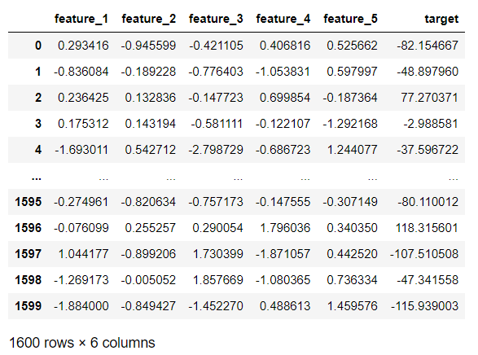
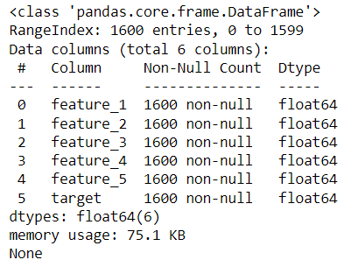

Slide 6
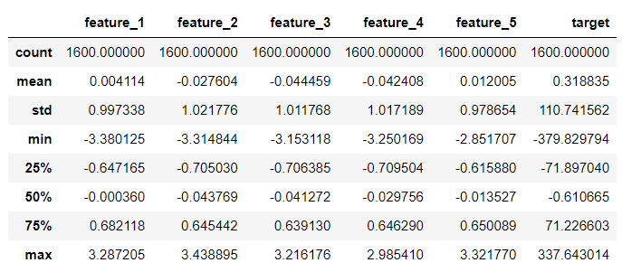
Then we got the summary statistics of the Data Frame:

Slide 7
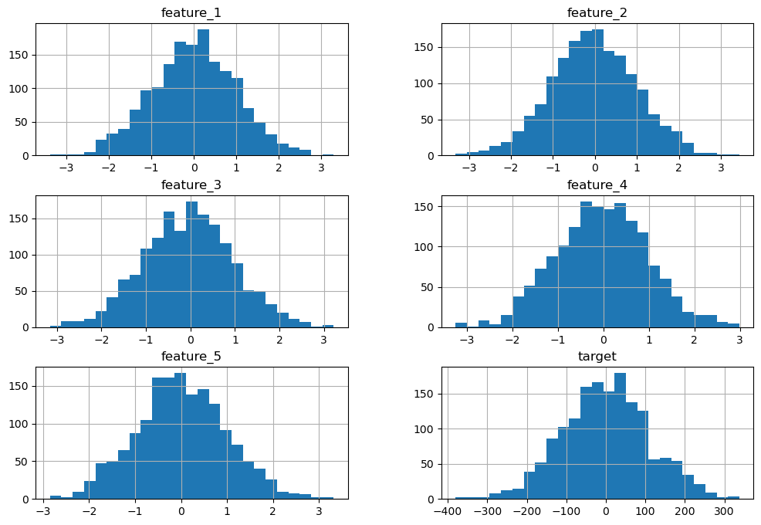
Then we plot the histograms of all columns and saw that data is in a bell-shaped curve :

Slide 8
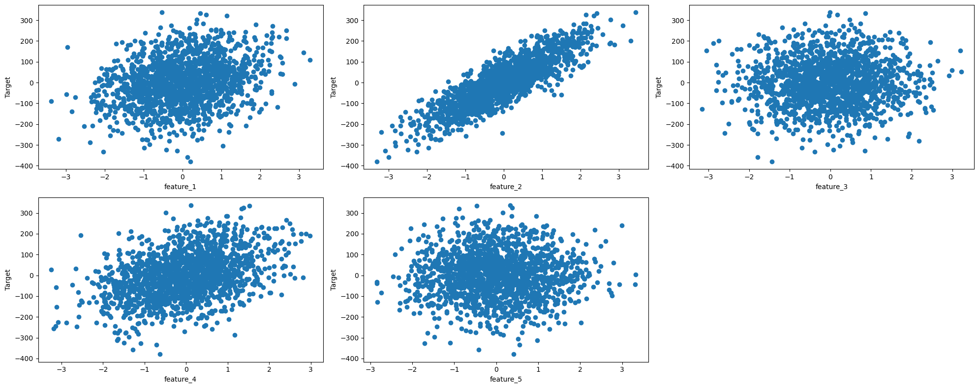
Then we found the scatter plots for each column against the target and noticed that there’s a linear relation between feature_2 vs target.

Slide 9
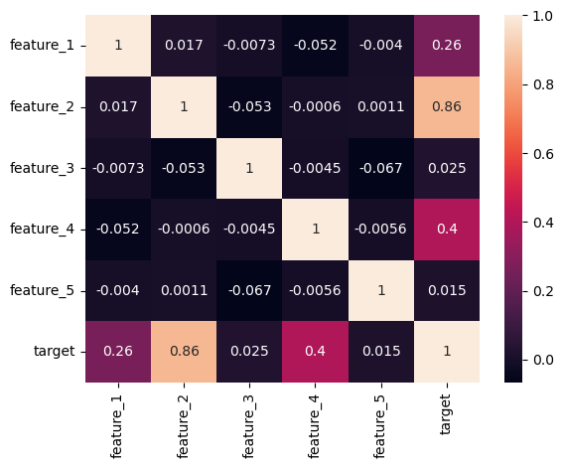
Then to find Pearson corelation coefficient, we plot the Corelation matrix heatmap and saw that there's a high corelation (i.e., 0.86) between feature_2 and target. Thus feature_2 and feature_4 are more important to predict target variable (i.e., AQI).

Slide 10
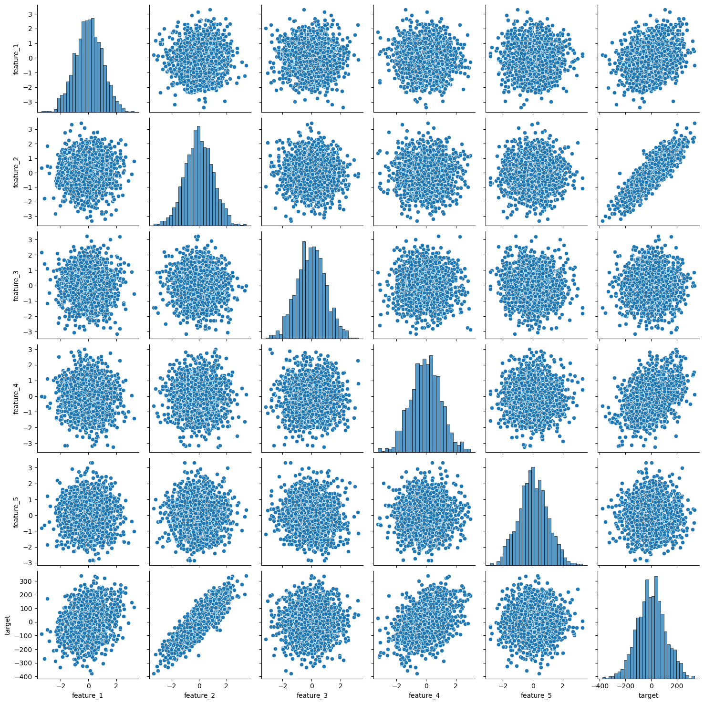
Now we did pair plot to find all graphs at once.

Slide 11
MAKING ML MODEL
Now we split the data into training and testing sets in 7:3 ratio and made a Linear regression model.
X indicates features/variables and y indicates target.
We made prediction on the test set and evaluated the model and printed the performance metrics and found:
The mean squared error is 430.015
The root mean squared error is 20.737
Which implies that the model is performing average or decent.
Then finally we combine the predicted values with the original test set and displayed the predicted values.

Slide 12
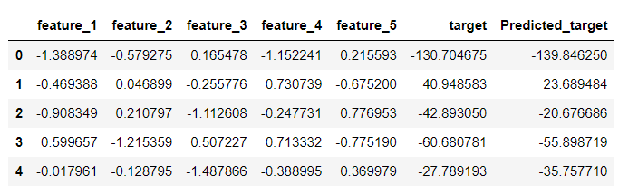
RESULTS
We found that target and predicted target values are approximately same which implies that our model is working decent.

Slide 13
CONCLUSION
We found that feature_2 which represent a polluting air particle has a linear relation with target or Air Quality Index, i.e., if feature_2 increases then target increases and if feature_2 decreases then target decreases. We saw that there's a high corelation (i.e., 0.86) between feature_2 and target and found that feature_2 and feature_4 are more important to predict target variable (i.e., AQI) from Corelation matrix heatmap.

